Slide 1

Improving internet security

Slide 2



Supervisor :
Shay Vargaftik
Ashraf Yassin
Amid Shibli

Slide 3
Agenda
Demonstration
Motivation
Project schema
Workspace
Encryption algorithm
Session Keys extraction
SSH packet structure
Wireshark simulation
Sniffer
Decryption
Proxy server
Data inspection

Slide 4

Demonstration

Slide 5

Motivation
Nowadays, most of the internet flows are encrypted, for example with the SSH protocol .
A problem with this approach is that a computer can be easily infected with malwares, since there is no mechanism to verify the integrity of the encrypted data.
A trusted proxy server that behaves as a man-in-the-middle between a client and a server and inspects the data flow between them, thus allowing only safe encrypted data.

Slide 6
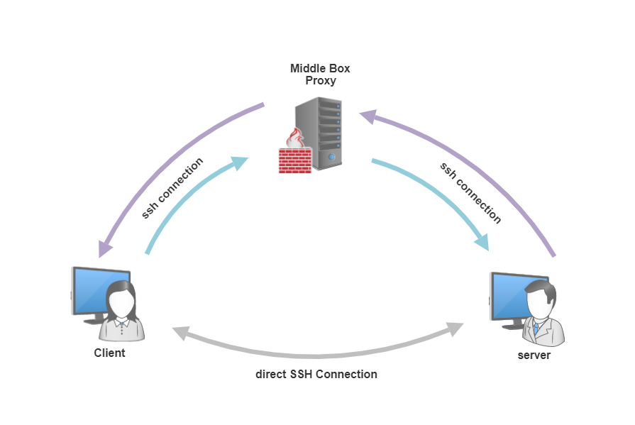
Project schema

Slide 7


Workspace
proxy
server
client
Three computer ( client, server, proxy )
Running on Linux Ubuntu 16.04 Operating System
Client has SSH version 7.6 source code implemented in C
Python scripts : aes-ctr128.py & proxy.py run in proxy

Slide 8








Slide 9
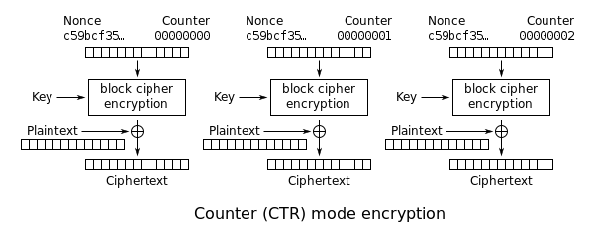
AES-CTR 128
Advanced Encryption Standard - Counter 128
Symmetric encryption that encrypts and decrypts with the same key .
Generates two keys for encryption that are valid only for the current session: 1. iv Counter. 2. Session key. Each key is 128 bits.
Encrypting packets block-by-block, with every block encryption the iv counter increases by one.

Slide 10
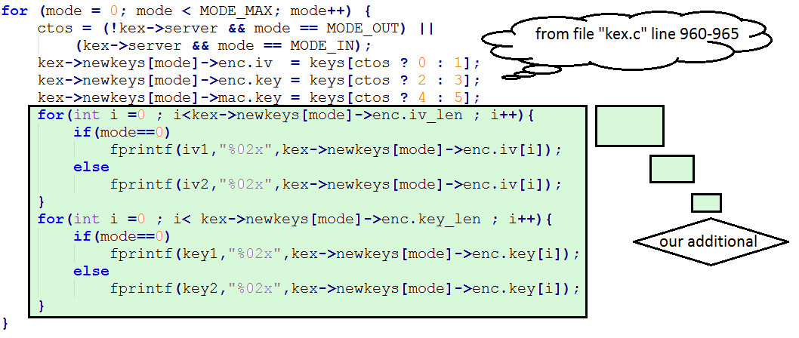
Session keys extraction
SSH implemented in C. The source code contains the C files that generate the encryption keys.
At the beginning of an SSH connection, the key pairs are generated in the client and server side.
In order to provide the proxy with these keys, after they are generated we save them in secret files.

Slide 11
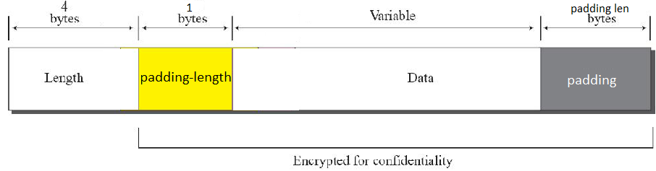
SSH packet structure
A packet consists of length ,padding length ,data and padding
Data in the packet consists of multiple blocks of size 128 bits .
Padding addition to the data in case data size is not a multiple of a block size.

Slide 12
Wireshark
Wireshark is a network packet analyzer that captures network packets and displays them in details .
Reveals network protocol internals.
Captures live packet data from a network interface .
Filters packets with respect to many criteria .

Slide 13
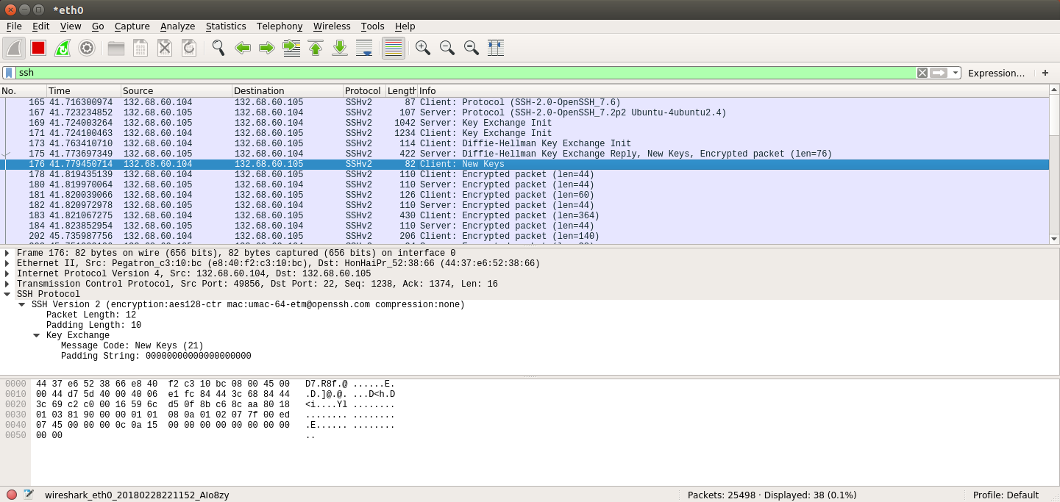

Slide 14
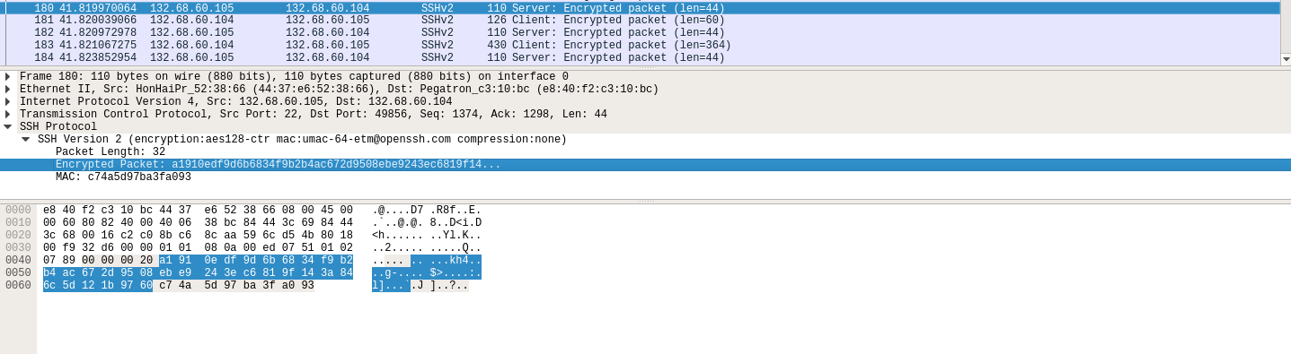

Slide 15
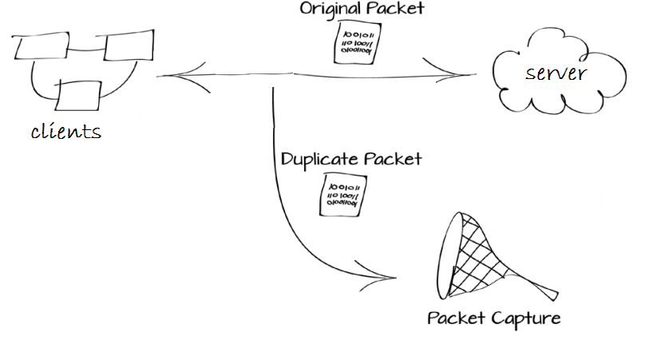
Sniffer
A script that sniffs out the data flowing over computer network links in real time
Used it to capture packets and decrypt them offline.

Slide 16
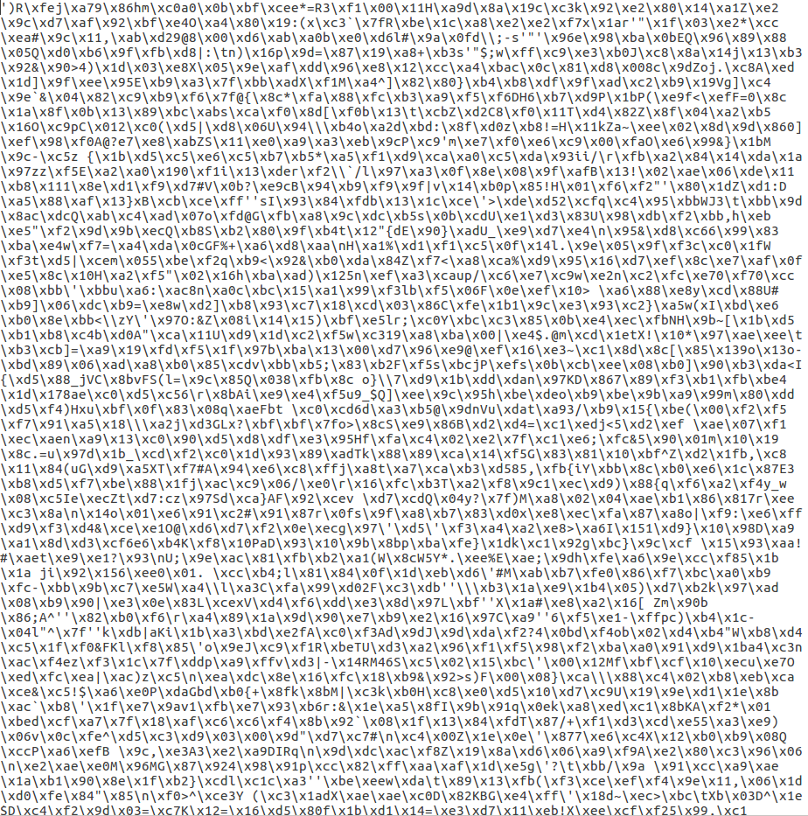
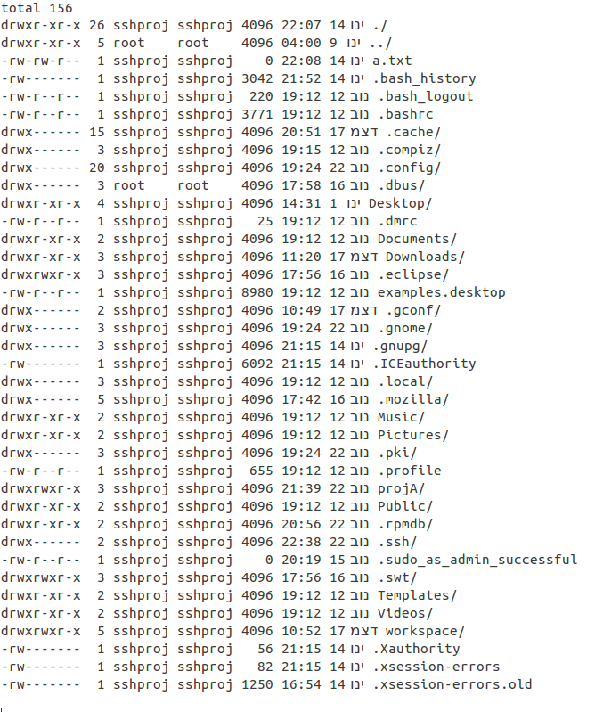

Decryption

Slide 17
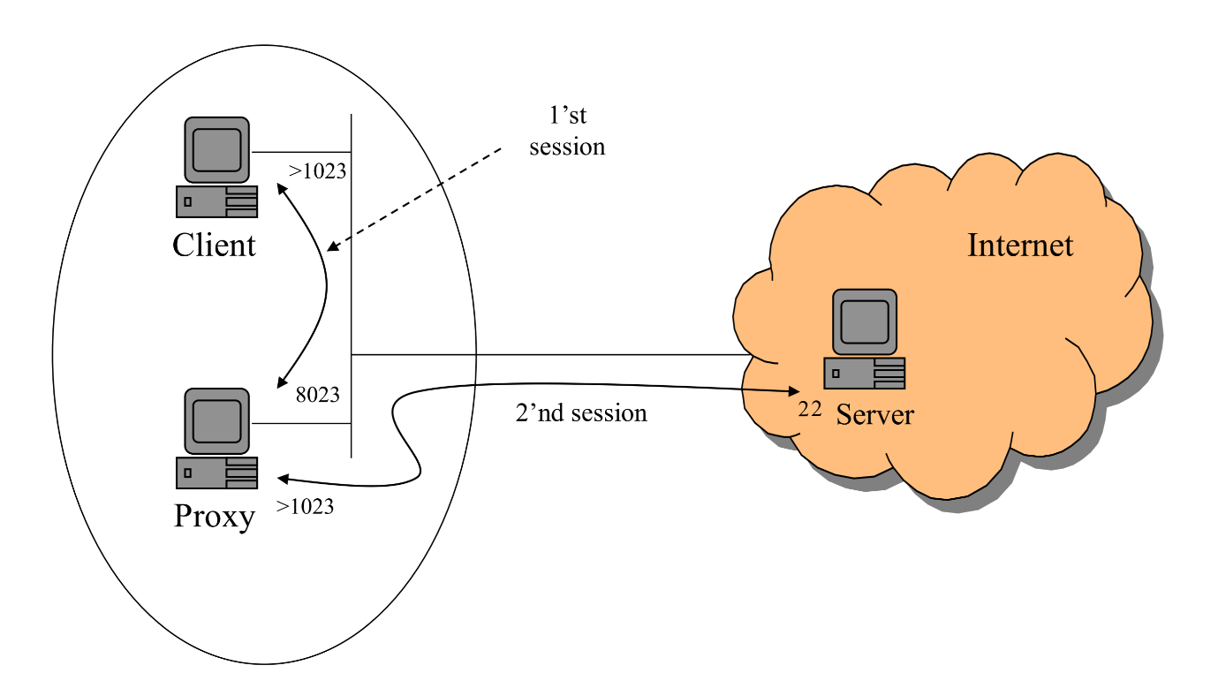
Proxy
Clients can connect to server either in direct way or via our proxy.
Setting up a proxy server that listens to SSH connection from clients
With each connection, the proxy creates a socket to communicate with the requested server.

Slide 18
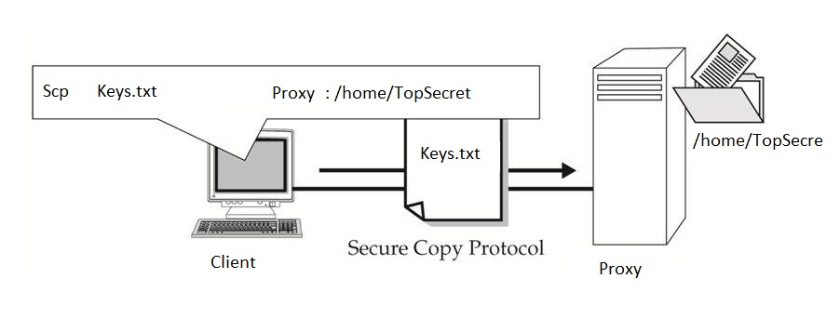
The proxy asks the client for the session keys in order to provide him with security.
Each arriving packet go through decryption and inspection process.

Slide 19
THE END

